Slide 1
Microsoft Dynamics CRM
Portal Capabilities
Arockia Jasmine A

Slide 2
CRM
What is CRM :
Customer relationship management (CRM) can be looked at as a business strategy which is defined to acquire and retain customers.
How it is achieved:
It makes use of Processes and supporting technology to identify and acquire new customers, retain existing customers, and enhance customer relationships

Slide 3
Benefits of CRM
Increase profitability in your sales, marketing, and service divisions
Centralize customer information
Automate marketing interactions
Provide business intelligence
Facilitate communications
Track sales opportunities
Analyze data
Enable responsive customer service

Slide 4
Microsoft Dynamics CRM
Microsoft Dynamics CRM is a customer relationship management application from Microsoft, that provides sales, service, and marketing capabilities. Microsoft sells Microsoft Dynamics CRM separately from the ERP products.
Dynamics CRM is a server-client application, which is primarily an IIS-based web application which also supports extensive web services interfaces. Clients access Dynamics CRM either by using a Browser or by a thick client plug-in to Microsoft Outlook.
The current version of Microsoft Dynamics CRM is 2016. Microsoft Dynamics CRM has over 40,000 customers

Slide 5
CRM Portals
A CRM portal is an extension to a CRM system.
A CRM portal is a way to open up the CRM system to people who are not CRM system users.
This allows them to work with and get information from the company in an efficient way, regardless of the time of the day.
CRM portals is a central place for making all types of information accessible, allowing organizations to extend business processes to the internet, expand their reach, and reduce costs across sales, service and marketing.

Slide 6
CRM Portals – Cont.
A CRM portal usually has two basic functions.
One is the ability to create and update records (which usually, but not necessarily, are records in the CRM system).
The other function is to provide access points for a variety of information that is relevant to the person logging in. This access is controlled based on who the user is, what their relationship with your company is, and the settings of the CRM Portal.

Slide 7
Benefits of CRM Portal
Features a login to a website.
Provides Rich Functionality.
Is Interactive - Supports Customer self-service.
Allows customers access to data related to them.
Is easy to administer and manage.
Delight the Customers
Data in one place. Data is managed in CRM system and is fed through the portal.
It's more efficient than email and phone.
It can drive multi-channel engagement.

Slide 8
Dynamics CRM portals
Customer portal
Partner portal
Community portal
Employee portal

Slide 9
Customer portal
A Customer Portal is often the most important and usually the first one to be implemented.
This portal provides implementations of the following features:
Knowledge base
Support
Forums
Self service

Slide 10
Partner portal
A Partner Portal provides a means of distributing and managing Partner Leads and opportunities, as well as providing the partner with the information they need to be effective.
This portal provides implementations of the following features:
Access and review new leads provided by the company.
Update lead status and opportunity information.
Generate a quotation.
Enter support tickets for partner’s customers.

Slide 11
Community portal
The community portal provides a method for organizations to develop deep relationships with their customers.
This portal provides implementations of the following features:
Content Publishing
Corporate Blogs
Discussion Forums
Idea crowdsourcing
Help Desk

Slide 12
Employee portal
An Employee Portal lets the employee enter help desk support requests, and provides a place where the employee can obtain information and forms that are needed.
This portal provides implementations of the following features:
Enter a Help Desk Ticket.
Review status of Help Desk Tickets previously entered.
Update employee address and contact information.
See company news, links, product information, available downloads, etc.

Slide 13
Demo

Slide 14
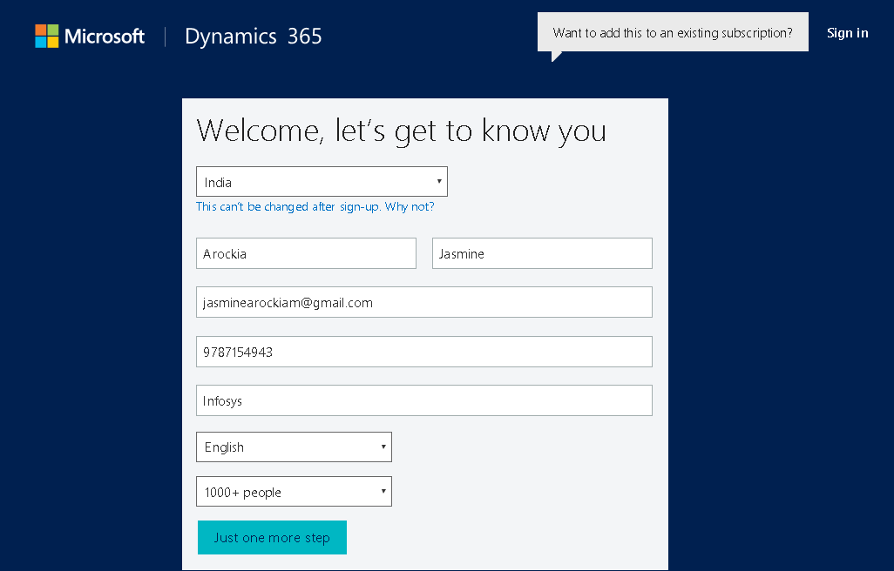
Setup and Configure Trial Portals
Step 1: Sign up for a trial account by clicking this link
https://www.microsoft.com/en-us/dynamics/free-crm-trial.aspx
Step 2: Click on “Get Started”
Step 3: Fill the details and Proceed.

Slide 15
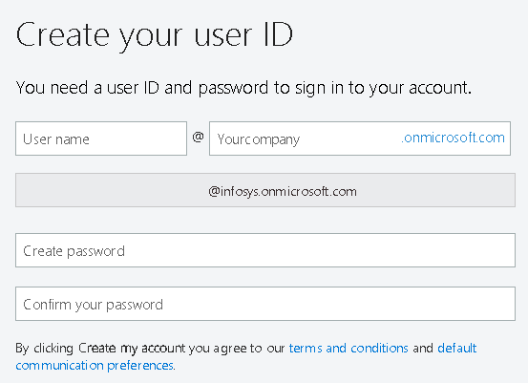
Setup and Configure Trial Portals - Cont.
Step 4: Enter User ID and Password to create a new user.

Slide 16
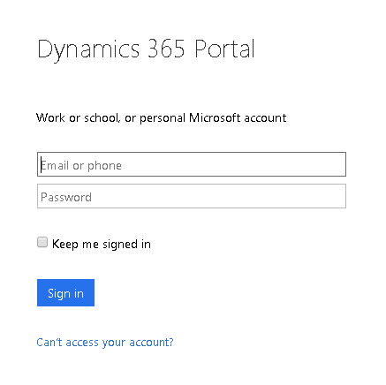
Setup and Configure Trial Portals - Cont.
Step 5: Sign in to the Dynamics CRM by clicking this link
https://www.microsoft.com/en-us/dynamics/crm-login.aspx

Slide 17
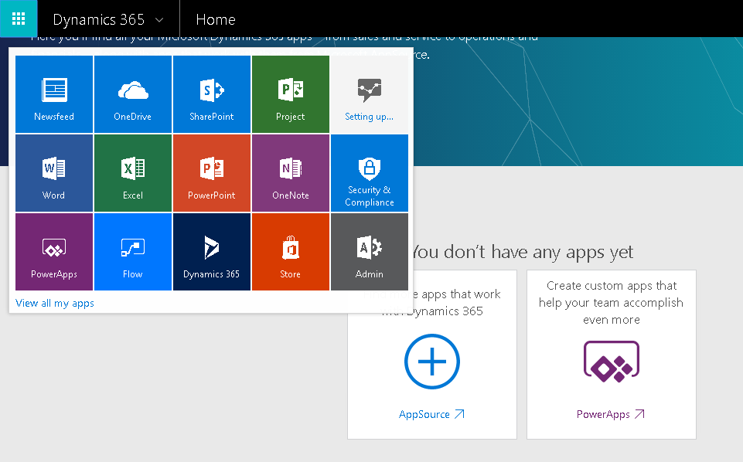
Setup and Configure Trial Portals - Cont.
Step 6: Click on “Admin” -> “Admin Center” -> “Dynamics 365”

Slide 18
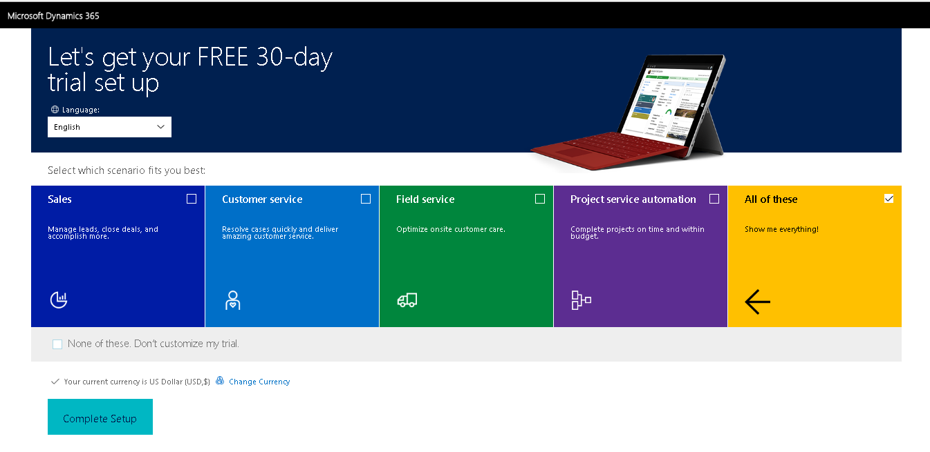
Setup and Configure Trial Portals - Cont.
Step 7: Click on “Complete Setup”

Slide 19
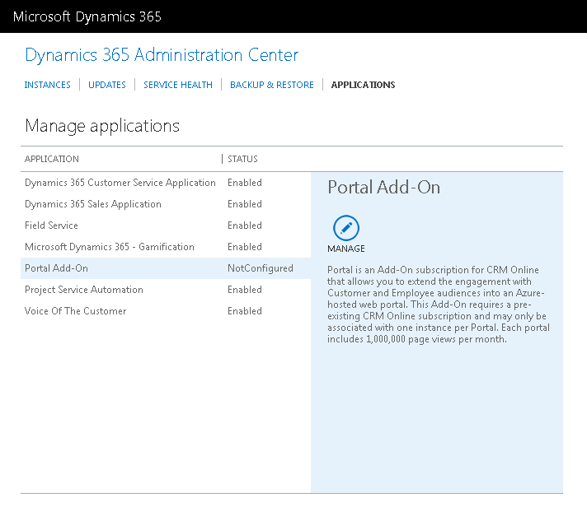
Setup and Configure Trial Portals - Cont.
Step 8: In Dynamics 365 Administration center click on “Applications”
Step 9: And then click on “Portal Add-On”
Step 10: Click on “Manage” button

Slide 20
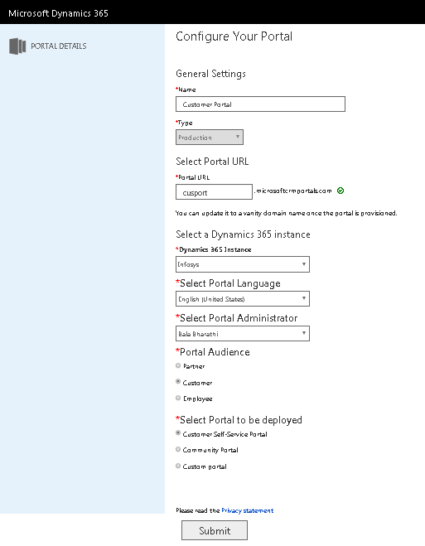
Setup and Configure Trial Portals - Cont.
Step 11: It will take you to the “Portal details” page where you have to fill in all the required details and Submit
Step 12: It will take some time (around 30 minutes) to setup everything

Slide 21
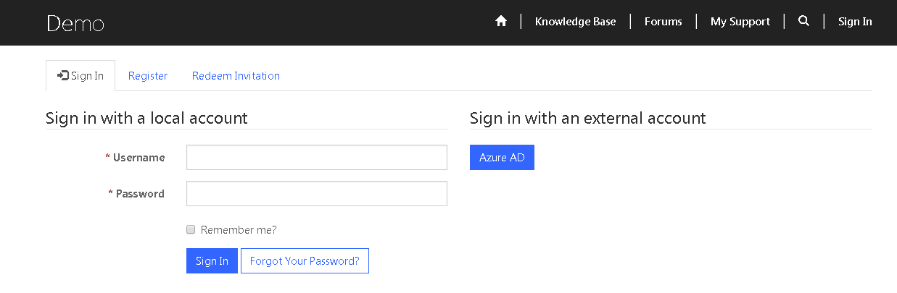
Setup and Configure Trial Portals - Cont.
Step 13: Portal can be accessed using this link
https://jas.microsoftcrmportals.com
Step 14: Customer can register and sign in to the portal

Slide 22
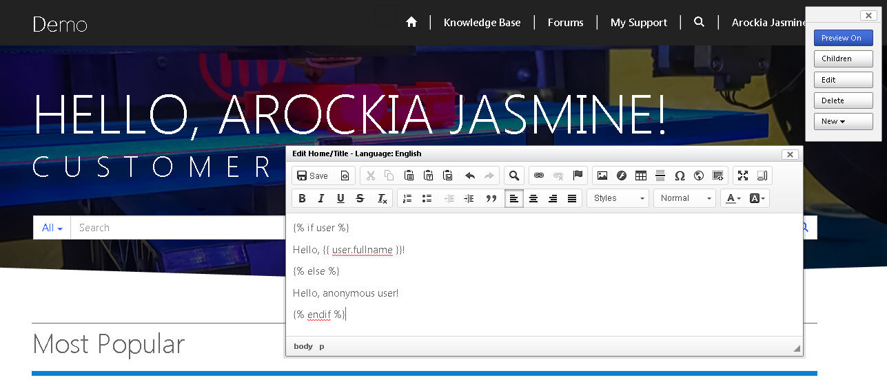
Setup and Configure Trial Portals - Cont.
Step 15: System administrator can login and directly edit the page.

Slide 23
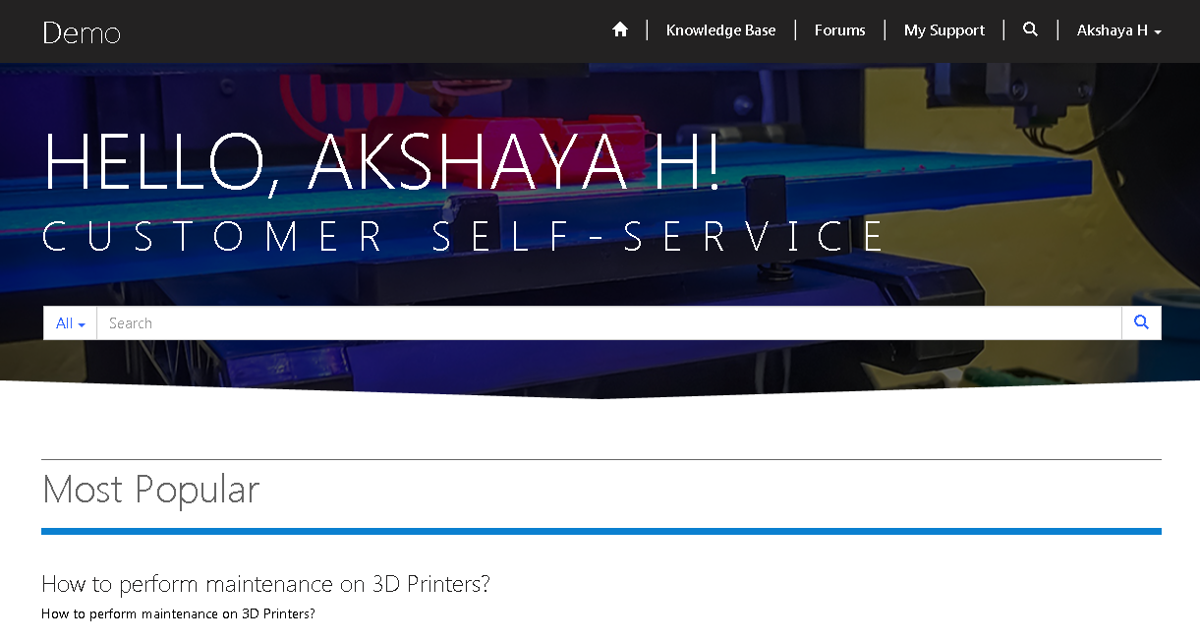
Setup and Configure Trial Portals - Cont.
Step 16: Customer can login and access Knowledge base, Forums and Support.

Slide 24
Thank You

